Slide 1
Software Project Management
Session 4: WBS, Estimation & Scheduling

Slide 2
Today & Next Week
Finish & Review Session 3
Work Breakdown Structures (WBS)
Estimation
Network Fundamentals
PERT & CPM Techniques
Gantt Charts
This slide set will likely roll-over to next week
Notes:
No lab today
More lab in later term

Slide 3
Charter: Homework 1
Distribution of project by type
  In-house, contract/for-hire, startup
Distribution of project by technology
  Web, Windows, No platform
Distribution by industry
  Fin. Svcs., Law, Retail
A reminder why no two projects are same

Slide 4
Charter: Homework 1
Most important elements
  Why, who, what, what not
  A little bit of when
Make sure it’s clear
Some more re-purposed than others
  Occasionally read more like biz plans
Make the stakeholder relationships clear
  You, sponsor, user, etc.

Slide 5
Charter: Homework 1
If “for real” you’d want additional assumptions and scope constraint
The justification or cost-benefit analysis “materializes” in some of the Charters
Don’t shortchange downstream activities
  Integration, testing, rollout, etc.

Slide 6
Charter: Homework 1
Risks
  Business risks vs. Project risks
    Ex: “lack of market adoption” vs. “inexperienced team”
Formalities
    Spell check.
    Make sure your name is on first page or footer.
Functionality
  “Forgotten” items: user registration, help, security

Slide 7
Charter: Homework 1
Good out of scope items
  Internationalization
  Search system

Slide 8
Real-world Case Study
Web-based customized reporting project
“How to Fail with the Rational Unified Process or 7 Steps to Pain and Suffering”

Slide 9
Project Considerations
Is infrastructure setup part of your project?
Assumptions
  What are you counting on?
  These can be critical to identify
  Resources expected: equip/people, approvals
  Availability of partners, connections
  Delineate key limits:
    System load: expect an maximum of 100 users

Slide 10
Session 3 Review
Full Lifecycle
  Know your pure waterfall, 7 phase model
  Understand the steps in each phase
  Know the primary issues and goals of each
  An example at a little consulting corp.
Methodologies
  Know a representative sample
  Waterfall, an variation, 1-2 iterative ones
  Be familiar with spectrum from XP->RUP
Planning, we’ll cover that now…

Slide 11
Session 3 Completion
Planning

Slide 12
Estimation
“Predictions are hard, especially about the future”, Yogi Berra
2 Types: Lucky or Lousy?

Slide 13
Planning, Estimating, Scheduling
What’s the difference?
Plan: Identify activities. No specific start and end dates.
Estimating: Determining the size & duration of activities.
Schedule: Adds specific start and end dates, relationships, and resources.

Slide 14
Project Planning: A 12 Step Program
Set goal and scope
Select lifecycle
Set org./team form
Start team selection
Determine risks
Create WBS
Identify tasks
Estimate size
Estimate effort
Identify task dependencies
Assign resources
Schedule work

Slide 15
How To Schedule
1. Identify “what” needs to be done
  Work Breakdown Structure (WBS)
2. Identify “how much” (the size)
  Size estimation techniques
3. Identify the dependency between tasks
  Dependency graph, network diagram
4. Estimate total duration of the work to be done
  The actual schedule

Slide 16
WBS & Estimation
How did you feel when I asked
  “How long will your project take?”
Not an easy answer to give right?
At least not if I were are real customer on a real project
How can you manage that issue?

Slide 17
Partitioning Your Project
You need to decompose your project into manageable chunks
ALL projects need this step
Divide & Conquer
Two main causes of project failure
  Forgetting something critical
  Ballpark estimates become targets
How does partitioning help this?

Slide 18
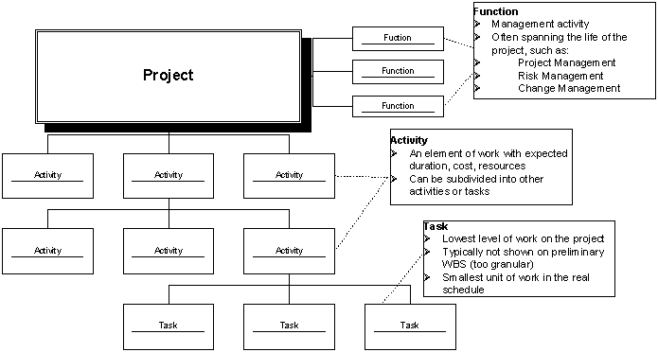
Project Elements
A Project: functions, activities, tasks

Slide 19
Work Breakdown Structure: WBS
Hierarchical list of project’s work activities
2 Formats
  Outline (indented format)
  Graphical Tree (Organizational Chart)
Uses a decimal numbering system
  Ex: 3.1.5
  0 is typically top level
Includes
  Development, Mgmt., and project support tasks
Shows “is contained in” relationships
Does not show dependencies or durations

Slide 20
WBS
Contract WBS (CWBS)
  First 2 or 3 levels
  High-level tracking
Project WBS (PWBS)
  Defined by PM and team members
  Tasks tied to deliverables
  Lowest level tracking

Slide 21
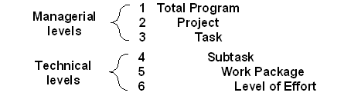
A Full WBS Structure
Up to six levels (3-6 usually) such as
Upper 3 can be used by customer for reporting (if part of RFP/RFQ)
Different level can be applied to different uses
  Ex: Level 1: authorizations; 2: budgets; 3: schedules

Slide 22
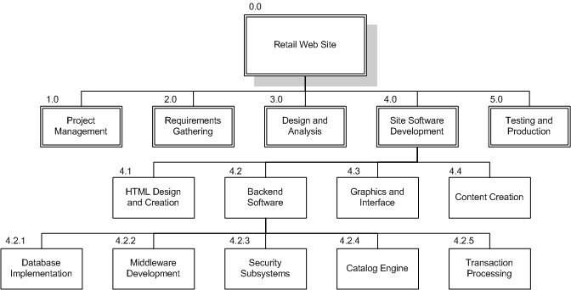
WBS Chart Example

Slide 23
WBS Outline Example
0.0 Retail Web Site
1.0 Project Management
2.0 Requirements Gathering
3.0 Analysis & Design
4.0 Site Software Development
4.1 HTML Design and Creation
4.2 Backend Software
4.2.1 Database Implementation
4.2.2 Middleware Development
4.2.3 Security Subsystems
4.2.4 Catalog Engine
4.2.5 Transaction Processing
4.3 Graphics and Interface
4.4 Content Creation
5.0 Testing and Production

Slide 24
WBS Types
Process WBS
    a.k.a Activity-oriented
    Ex: Requirements, Analysis, Design, Testing
    Typically used by PM
Product WBS
    a.k.a. Entity-oriented
    Ex: Financial engine, Interface system, DB
    Typically used by engineering manager
Hybrid WBS: both above
    This is not unusual
    Ex: Lifecycle phases at high level with component or feature-specifics within phases
    Rationale: processes produce products

Slide 25
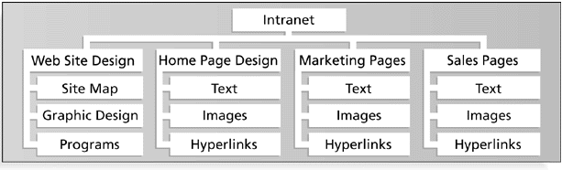
Product WBS

Slide 26
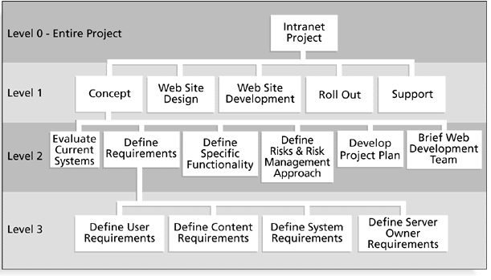
Process WBS

Slide 27
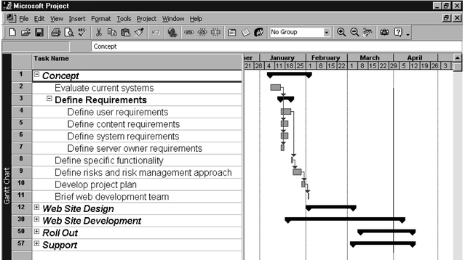
Outline WBS w/Gantt

Slide 28
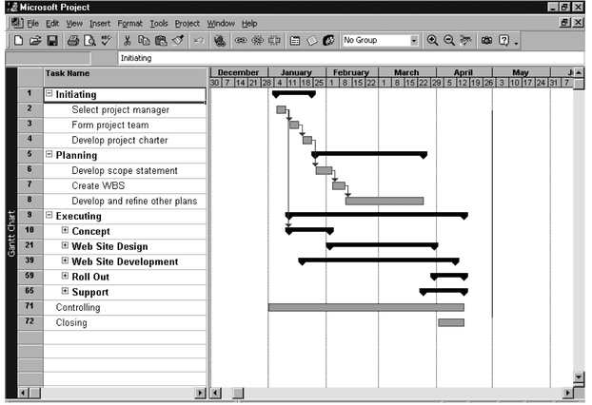
WBS by PMI Process Groups

Slide 29
WBS Types
Less frequently used alternatives
  Organizational WBS
    Research, Product Design, Engineering, Operations
    Can be useful for highly cross-functional projects
  Geographical WBS
    Can be useful with distributed teams
    NYC team, San Jose team, Off-shore team

Slide 30
Work Packages
Generic term for discrete tasks with definable end results
Typically the “leaves” on the tree
The “one-to-two” rule
    Often at: 1 or 2 persons for 1 or 2 weeks
Basis for monitoring and reporting progress
    Can be tied to budget items (charge numbers)
    Resources (personnel) assigned
Ideally shorter rather than longer
    Longer makes in-progress estimates needed
    These are more subjective than “done”
    2-3 weeks maximum for software projects
    1 day minimum (occasionally a half day)
    Not so small as to micro-manage

Slide 31
WBS
List of Activities, not Things
List of items can come from many sources
  SOW, Proposal, brainstorming, stakeholders, team
Describe activities using “bullet language”
  Meaningful but terse labels
All WBS paths do not have to go to the same level
Do not plan more detail than you can manage

Slide 32
WBS & Methodology
PM must map activities to chosen lifecycle
Each lifecycle has different sets of activities
Integral process activities occur for all
  Planning, configuration, testing
Operations and maintenance phases are not normally in plan (considered post-project)
Some models are “straightened” for WBS
  Spiral and other iterative models
  Linear sequence several times
Deliverables of tasks vary by methodology

Slide 33
WBS Techniques
Top-Down
Bottom-Up
Analogy
Rolling Wave
  1st pass: go 1-3 levels deep
  Gather more requirements or data
  Add more detail later
Post-its on a wall

Slide 34
WBS Techniques
Top-down
  Start at highest level
  Systematically develop increasing level of detail
  Best if
    The problem is well understood
    Technology and methodology are not new
    This is similar to an earlier project or problem
  But is also applied in majority of situations

Slide 35
WBS Techniques
Bottom-up
  Start at lowest level tasks
  Aggregate into summaries and higher levels
  Cons
    Time consuming
    Needs more requirements complete
  Pros
    Detailed

Slide 36
WBS Techniques
Analogy
  Base WBS upon that of a “similar” project
  Use a template
  Analogy also can be estimation basis
  Pros
    Based on past actual experience
  Cons
    Needs comparable project

Slide 37
WBS Techniques
Brainstorming
  Generate all activities you can think of that need to be done
  Group them into categories
Both Top-down and Brainstorming can be used on the same WBS
Remember to get the people who will be doing the work involved (buy-in matters!)

Slide 38
WBS – Basis of Many Things
Network scheduling
Costing
Risk analysis
Organizational structure
Control
Measurement

Slide 39
WBS Guidelines Part 1
Should be easy to understand
Some companies have corporate standards for these schemes
Some top-level items, like Project Mgmt. are in WBS for each project
  Others vary by project
What often hurts most is what’s missing
Break down until you can generate accurate time & cost estimates
Ensure each element corresponds to a deliverable

Slide 40
WBS Guidelines Part 2
How detailed should it be?
  Not as detailed as the final MS-Project plan
  Each level should have no more than 7 items
  It can evolve over time
What tool should you use?
  Excel, Word, Project
  Org chart diagramming tool (Visio, etc)
  Specialized commercial apps
Re-use a “template” if you have one

Slide 41
Estimations
Very difficult to do, but needed often
Created, used or refined during
  Strategic planning
  Feasibility study and/or SOW
  Proposals
  Vendor and sub-contractor evaluation
  Project planning (iteratively)
Basic process
  Estimate the size of the product
  Estimate the effort (man-months)
  Estimate the schedule
  NOTE: Not all of these steps are always explicitly performed

Slide 42
Estimations
Remember, an “exact estimate” is an oxymoron
Estimate how long will it take you to get home from class tonight
  On what basis did you do that?
  Experience right?
  Likely as an “average” probability
  For most software projects there is no such ‘average’
Most software estimations are off by 25-100%

Slide 43
Estimation
Target vs. Committed Dates
    Target: Proposed by business or marketing
    Do not commit to this too soon!
    Committed: Team agrees to this
    After you’ve developed a schedule

Slide 44
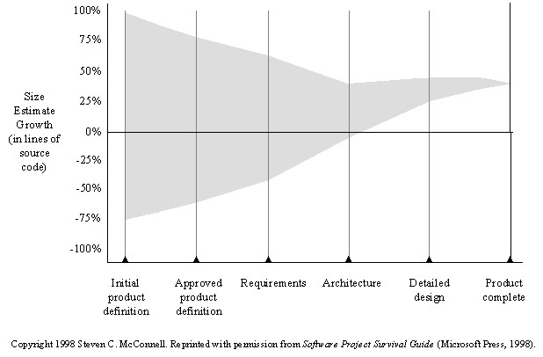
Cone of Uncertainty

Slide 45
Estimation
Size:
  Small projects (10-99 FPs), variance of 7% from post-requirements estimates
  Medium (100-999 FPs), 22% variance
  Large (1000-9999 FPs) 38% variance
  Very large (> 10K FPs) 51% variance

Slide 46
Estimation Methodologies
Top-down
Bottom-up
Analogy
Expert Judgment
Priced to Win
Parametric or Algorithmic Method
  Using formulas and equations

Slide 47
Top-down Estimation
Based on overall characteristics of project
  Some of the others can be “types” of top-down (Analogy, Expert Judgment, and Algorithmic methods)
Advantages
  Easy to calculate
  Effective early on (like initial cost estimates)
Disadvantages
  Some models are questionable or may not fit
  Less accurate because it doesn’t look at details

Slide 48
Bottom-up Estimation
Create WBS
Add from the bottom-up
Advantages
  Works well if activities well understood
Disadvantages
  Specific activities not always known
  More time consuming

Slide 49
Expert Judgment
Use somebody who has recent experience on a similar project
You get a “guesstimate”
Accuracy depends on their ‘real’ expertise
Comparable application(s) must be accurately chosen
  Systematic
Can use a weighted-average of opinions

Slide 50
Estimation by Analogy
Use past project
  Must be sufficiently similar (technology, type, organization)
  Find comparable attributes (ex: # of inputs/outputs)
  Can create a function
Advantages
  Based on actual historical data
Disadvantages
  Difficulty ‘matching’ project types
  Prior data may have been mis-measured
  How to measure differences – no two exactly same

Slide 51
Priced to Win
Just follow other estimates
Save on doing full estimate
Needs information on other estimates (or prices)
Purchaser must closely watch trade-offs
Priced to lose?

Slide 52
Algorithmic Measures
Lines of Code (LOC)
Function points
Feature points or object points
Other possible
  Number of bubbles on a DFD
  Number of of ERD entities
  Number of processes on a structure chart
LOC and function points most common
  (of the algorithmic approaches)
Majority of projects use none of the above

Slide 53
Code-based Estimates
LOC Advantages
  Commonly understood metric
  Permits specific comparison
  Actuals easily measured
LOC Disadvantages
  Difficult to estimate early in cycle
  Counts vary by language
  Many costs not considered (ex: requirements)
  Programmers may be rewarded based on this
    Can use: # defects/# LOC
  Code generators produce excess code

Slide 54
LOC Estimate Issues
How do you know how many in advance?
What about different languages?
What about programmer style?
Stat: avg. programmer productivity: 3,000 LOC/yr
Most algorithmic approaches are more effective after requirements (or have to be after)

Slide 55
Function Points
Software size s/b measured by number & complexity of functions it performs
More methodical than LOC counts
House analogy
  House’s Square Feet ~= Software LOC
  # Bedrooms & Baths ~= Function points
  Former is size only, latter is size & function
Six basic steps

Slide 56
Function Point Process
1. Count # of biz functions per category
  Categories: outputs, inputs, db inquiries, files or data structures, and interfaces
2. Establish Complexity Factor for each and apply
  Simple, Average, Complex
  Set a weighting multiplier for each (0->15)
  This results in the “unadjusted function-point total”
3. Compute an “influence multiplier” and apply
  It ranges from 0.65 to 1.35; is based on 14 factors
4. Results in “function point total”
  This can be used in comparative estimates

Slide 57
Wideband Delphi
Group consensus approach
Rand corp. used orig. Delphi approach to predict future technologies
Present experts with a problem and response form
Conduct group discussion, collect anonymous opinions, then feedback
Conduct another discussion & iterate until consensus
Advantages
  Easy, inexpensive, utilizes expertise of several people
  Does not require historical data
Disadvantages
  Difficult to repeat
  May fail to reach consensus, reach wrong one, or all may have same bias

Slide 58
Parametric Method Issues
Remember: most projects you’ll run into don’t use these
Which is ‘normal’, so don’t be surprised
  Or come-in to new job and say “Hey, let’s use COCOMO”
These are more effective on large projects
  Where a past historical base exists
Primary issue for most projects are
  Lack of similar projects
    Thus lack of comparable data
Catch-22: how to get started

Slide 59
Code Reuse & Estimation
Does not come for free
Code types: New, Modified, Reused
If code is more than 50% modified, it’s “new”
Reuse factors have wide range
  Reused code takes 30% effort of new
  Modified is 60% of new
Integration effort with reused code almost as expensive as with new code

Slide 60
Effort Estimation
Now that you know the “size”, determine the “effort” needed to build it
Various models: empirical, mathematical, subjective
Expressed in units of duration
  Man-months (or ‘staff-months’ now)

Slide 61
Effort Estimation
McConnell shows schedule tables for conversion of size to effort
As with parametric size estimation, these techniques perform better with historical data
Again, not seen in ‘average’ projects
Often the size and effort estimation steps are combined (not that this is recommended, but is what often is done)
“Commitment-Based” Scheduling is what is often done
  Ask developer to ‘commit’ to an estimate (his or her own)

Slide 62
COCOMO
COnstructive COst MOdel
Allows for the type of application, size, and “Cost Drivers”
Outputs in Person Months
Cost drivers using High/Med/Low & include
  Motivation
  Ability of team
  Application experience
Biggest weakness?
  Requires input of a product size estimate in LOC

Slide 63
Estimation Issues
Quality estimations needed early but information is limited
Precise estimation data available at end but not needed
  Or is it? What about the next project?
Best estimates are based on past experience
Politics of estimation:
  You may anticipate a “cut” by upper management
For many software projects there is little or none
  Technologies change
  Historical data unavailable
  Wide variance in project experiences/types
  Subjective nature of software estimation

Slide 64
Over and Under Estimation
Over estimation issues
  The project will not be funded
    Conservative estimates guaranteeing 100% success may mean funding probability of zero.
  Parkinson’s Law: Work expands to take the time allowed
  Danger of feature and scope creep
  Be aware of “double-padding”: team member + manager
Under estimation issues
  Quality issues (short changing key phases like testing)
  Inability to meet deadlines
  Morale and other team motivation issues

Slide 65
Estimation Guidelines
Estimate iteratively!
  Process of gradual refinement
  Make your best estimates at each planning stage
  Refine estimates and adjust plans iteratively
  Plans and decisions can be refined in response
  Balance: too many revisions vs. too few

Slide 66
Know Your Deadlines
Are they ‘Real Deadlines’?
  Tied to an external event
  Have to be met for project to be a success
  Ex: end of financial year, contractual deadline, Y2K
Or ‘Artificial Deadlines’?
  Set by arbitrary authority
  May have some flexibility (if pushed)

Slide 67
Estimation “Presentation”
How you present the estimation can have huge impact
Techniques
    Plus-or-minus qualifiers
      6 months +/-1 month
    Ranges
      6-8 months
    Risk Quantification
      +/- with added information
      +1 month of new tools not working as expected
      -2 weeks for less delay in hiring new developers
    Cases
      Best / Planned / Current / Worst cases
    Coarse Dates
      Q3 02
    Confidence Factors
      April 1 – 10% probability, July 1 – 50%, etc.

Slide 68
Other Estimation Factors
Account for resource experience or skill
  Up to a point
  Often needed more on the “low” end, such as for a new or junior person
Allow for “non-project” time & common tasks
  Meetings, phone calls, web surfing, sick days
There are commercial ‘estimation tools’ available
  They typically require configuration based on past data

Slide 69
Other Estimation Notes
Remember: “manage expectations”
Parkinson’s Law
  “Work expands to fill the time available”
The Student Syndrome
  Procrastination until the last minute (cram)

Slide 70
Mythical Man-Month Revisited
Back to notes from class 2

Slide 71
Financial Analysis of Projects
Financial considerations are often an important consideration in selecting projects
Three primary methods for determining the projected financial value of projects:
  Net present value (NPV) analysis
  Return on investment (ROI)
  Payback analysis

Slide 72
Net Present Value Analysis: NPV
NPV: a method of calculating the expected net monetary gain or loss from a project by discounting all expected future cash inflows and outflows to the present point in time
Projects with a positive NPV should be considered if financial value is a key criterion
The higher the NPV, the better

Slide 73
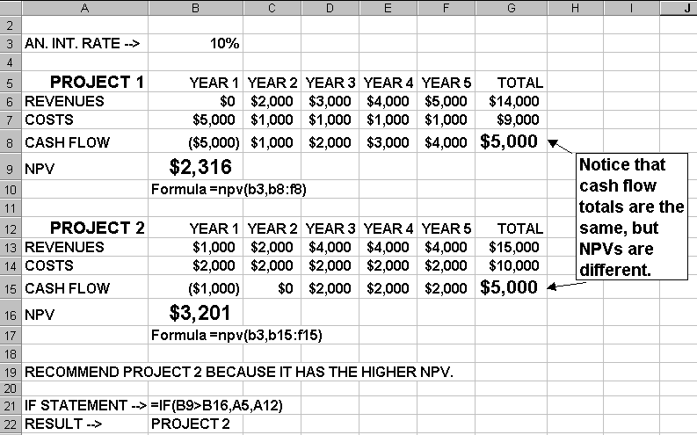
NPV Example

Slide 74
Return on Investment (ROI)
ROI: income divided by investment
  ROI = (total discounted benefits - total discounted costs) / discounted costs
The higher the ROI, the better
Many organizations have a required rate of return or minimum acceptable rate of return on investment for projects

Slide 75
Payback Analysis
Another important financial consideration is payback analysis
The “payback period” is the amount of time it will take to recoup, in the form of net cash inflows, the net dollars invested in a project
Payback occurs when the cumulative discounted benefits and costs are greater than zero
Many organizations want IT projects to have a fairly short payback period

Slide 76
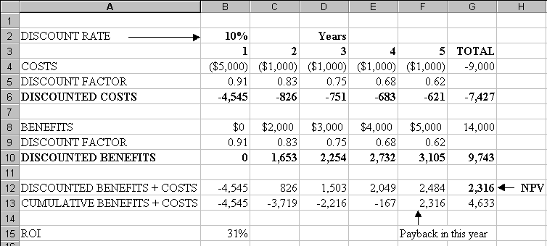
NPV, ROI, Payback Period: Ex 1

Slide 77
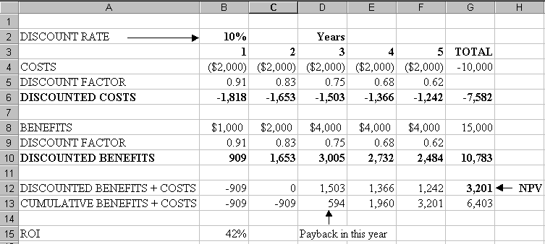
NPV, ROI, Payback Period: Ex 2

Slide 78
Weighted Scoring Model
A weighted scoring model is a tool that provides a systematic process for selecting projects based on many criteria
    First identify criteria important to the project selection process
    Then assign weights (percentages) to each criterion so they add up to 100%
    Then assign scores to each criterion for each project
    Multiply scores * weights = total weighted scores
The higher the weighted score, the better

Slide 79
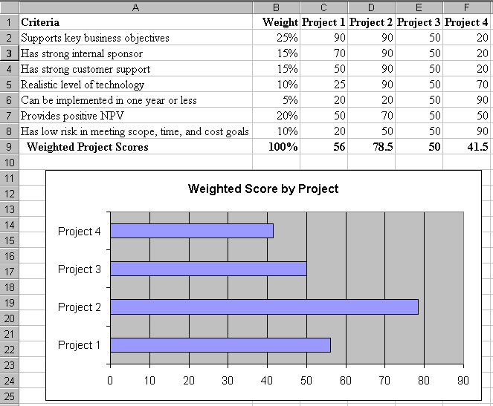
Sample Weighted Scoring Model

Slide 80
Homework
McConnell: 9, “Scheduling”
Schwalbe: 5, “Project Time Management”
URLs: See class web site for URLs on PERT/CPM
Create a WBS for your project

Slide 81
WBS Homework
The fine print
    You only need to do this down to level 2 (or 3 if your so inclined or that helps clarify some higher-level activities). Going to level 2 means means start with level 0 (a single node – the name of your project), level 1, the highest level breakdown (4-7 nodes), and one level below that. You can go deeper at your discretion.
    As we covered in class, you can use either a process, product or hybrid approach. For most of your projects I suspect the process approach would work best at the highest level.
    You can use either Excel, Word, or Project. Follow the standard hierarchical numbering scheme for WBS structures.
    Please think this through. You’re the PM now.

Slide 82
Questions?

